Slide 1
CS/COE 0447
MIPS: Programs, Instructions, and Registers
wilkie (with content borrowed from:
Jarrett Billingsley
Dr. Bruce Childers)

Slide 2
Programs and Instructions
Programs? What are they…

Slide 3
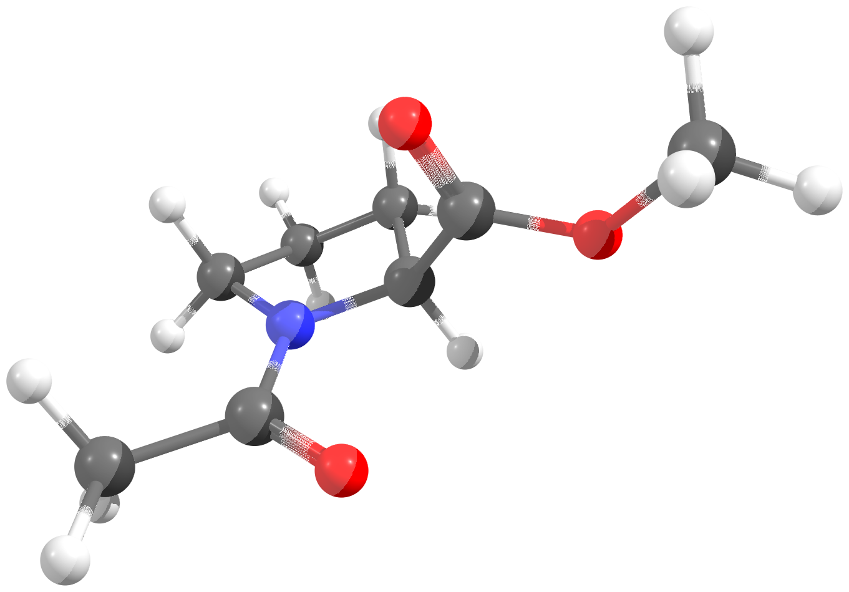
Programs? Instructions? What are they?
Chemistry/Physics Analogy:
Instructions are “atoms” and programs are “molecules”
Molecules have structure...
And that structure is often functional
And potentially nonsense… but whatever.

Slide 4
What are they really, though?
Instructions are single, simple operations that a computer can carry out.
“add two numbers together”
“move a number from here to there”
“go to this place in the program” (jump)
“search this string for a character” (they can be complex)
Programs are a series of these tiny instructions.
Well, how do we create these instructions?
How does a computer understand them?
(again… how does a computer understand anything???)

Slide 5
Assembly vs. Machine Language
machine language instructions are the patterns of bits that a processor reads to know what to do
assembly language (or "asm") is a human-readable, textual representation of machine language
MIPS asm | MIPS machine language
lw t0, 1200(t1) | 100011 01001 01000 0000010010110000 lw t1 t0 1200
add t2, s2, t0 | 000000 10010 01000 01010 00000 100000 <math> s2 t0 t2 n/a add
sw t2, 1200(t1) | 101011 01001 01010 0000010010110000 sw t1 t2 1200

Slide 6
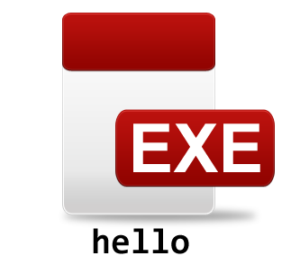
What about “compilers”?
#include <stdio.h>
int main() {
printf("hello!");
return 0;
}
gcc
hello.o
libc.a
(for more information, take CS0449!)
Source Code
Compiler
Object Files
converts C code to machine code
ld
sticks pieces of machine code together to make a program
Linker
Executable

Slide 7
Virtual Machines?
class Hello {
public static void
System.out.printl
}
}
javac
Hello.class
Hello.jar
0010100011100000011101101110100110010100010010010100111
Source Code
Compiler
Intermediate Language Code
Machine Code
converts Java code to machine code for a CPU that doesn't exist
java
JIT
can be distributed to end users
Virtual Machine
Just-in-time Compiler

Slide 8
Virtual Machines: Why learning asm matters!
Developing Virtual Machine “intermediate languages” is like developing a processor.
It’s a great way to make your software more portable!
Pioneered by Infocom for text adventures
Lots of different computers with little standardization…
So just create your many games for hypothetical hardware
Then you just port the game engine. Genius!
You develop your own ISA (instruction set architecture)
Aside: https://ryiron.wordpress.com/2017/02/01/finding-the-lost-vikings-reversing-a-virtual-machine/ (Lost Vikings)

Slide 9
How a CPU runs a program!
Step 1: Read next instruction
Step 2: Do the instruction
Step 3: Go to step 1
Ok… maybe there’s a little more to it...

Slide 10
How a CPU runs a program!
Memory
Persistent Storage
Program
Program
Control
Registers
A
B
3
5
8
instruction
C
Datapath
"C = A + B"
+
…and repeat!
Processor
We will focus on this later on!

Slide 11
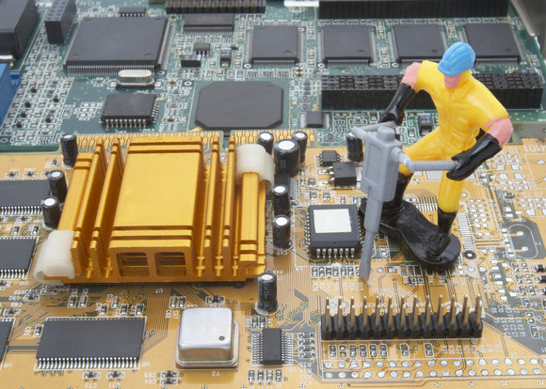
How do we construct a CPU?
Not like this

Slide 12
ISAs
Instruction Set Architecture

Slide 13
Instruction Set Architecture (ISA)
An ISA is the interface that a CPU presents to the programmer
when we say "architecture," this is what we mean
It defines:
what the CPU can do (add, subtract, call functions, etc.)
what registers it has (we'll get to those)
the machine language
that is, the bit patterns used to encode instructions
It does not define:
how to design the hardware!
…if there's any hardware at all (remember: virtual/hypothetical ISAs)

Slide 14
ISA Example: X86
descended from 16-bit 8086 CPU from 1978
extended to 32 bits, then 64
each version can run most programs from the previous version
you can run programs written in 1978 on a brand new CPU!
“so why don't we learn x86 in this course?”
It can do a lot of things…
Its machine language is very complex! (40 years of growth!!)
Making an x86 CPU is… difficult.
Ultimately, we would waste a ton of time.

Slide 15
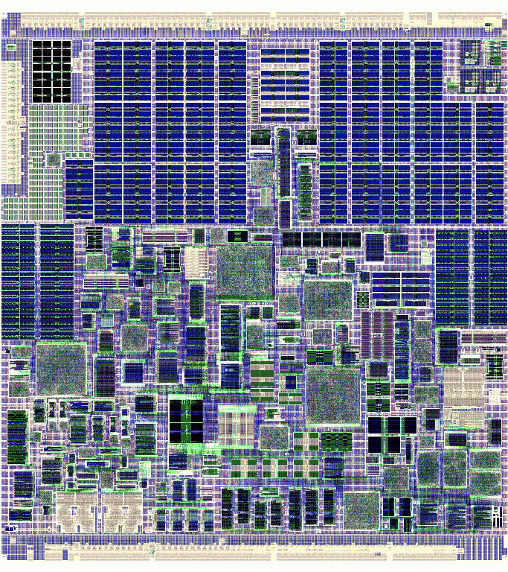
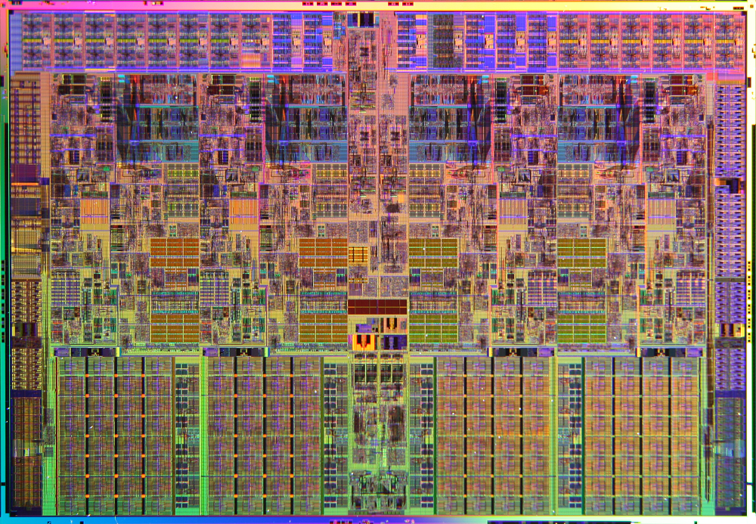
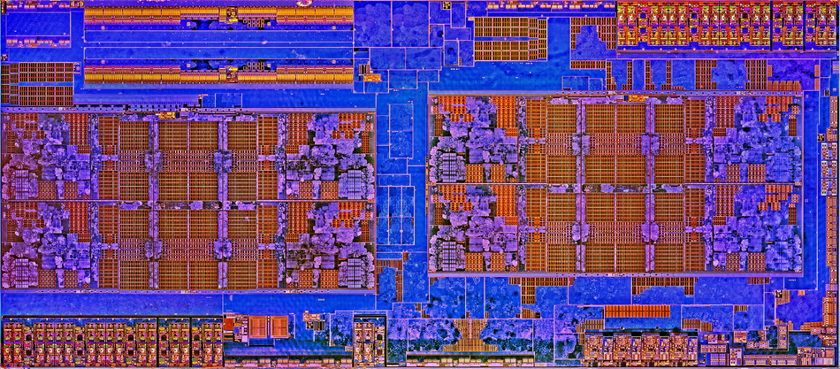
All three processors run the same programs…
but they're TOTALLY different on the inside
VIA Nano
AMD Zen
Intel Core i7

Slide 16
Types of ISAs: CISC
CISC: "Complex Instruction Set Computer"
ISA designed for humans to write asm
from the days before compilers!
lots of instructions and ways to use them
complex (multi-step) instructions to shorten and simplify programs
"search a string for a character"
"copy memory blocks"
"check the bounds of an array access“
Without these, you’d just write your programs to use the simpler instructions to build the complex behavior itself.
x86 is very CISCy

Slide 17
Types of ISAs: RISC
RISC: "Reduced Instruction Set Computer"
ISA designed to make it easy to:
build the CPU hardware
make that hardware run fast
write compilers that make machine code
a small number of instructions
instructions are very simple
MIPS is very RISCy
MIPS and RISC were the original RISC architectures developed at two universities in California
the research leads were… Patterson and Hennessy…

Slide 18
Popular ISAs Today:
x86 (these days, it’s x86-64 or “x64”)
most laptops/desktops/servers have one
(modern x86 CPUs are just RISC CPUs that can read the weird x86 instructions)
ARM
almost everything else has one
ARMv8 (AArch64) is pretty similar to MIPS!
Everything else: Alpha, Sparc, POWER/PPC, z, z80, 29K, 68K, 8051, PIC, AVR, Xtensa, SH2/3/4, 68C05, 6502, SHARC, MIPS...
microcontrollers, mainframes, some video game consoles, and historical/legacy applications
despite its limited use today, MIPS has been incredibly influential! (Essentially all RISC chips model it)

Slide 19

Types of ISAs: Overview
CISC: Complex Instruction Set Computer (does a whole lot)
RISC: Reduced Instruction Set Computer (does enough)
Both: Equivalent!! (RISC programs might be longer)
“Hackers” (1995) – Of course, they are talking about a Pentium x86 chip… which thanks to its backwards compatibility, is CISC. Oh well!

Slide 20
The MIPS ISA: Registers
The Local Storage of the MIPS CPU

Slide 21
Registers
registers are a kind of small, fast, temporary memory inside the CPU
the CPU can only operate on data in registers
MIPS has 32 registers, and each is 32 bits (one word)
the registers are numbered 0 to 31… ($0, $17, $31)
…but they also have nice names ($a0, $t1, $bp)
(I’m ambivalent about the dollar signs)
(Jarrett modified MARS so you don't have to use them)
add $t0, $a0, $a1 (t0 = a0 + a1)
(or) add t0, a0, a1

Slide 22
Juggling Data
Registers are… like….. hands.
You have a limited number and they can only hold small things.
Your program's variables primarily live in memory.
The registers are just a temporary stopping point for those values.
IMPORTANT!
less important
Memory
Registers
3
5
8
A
B
C
“longer-term”
“short-term”

Slide 23
Really… You don’t have that many…
You cannot write every program using only registers
don't try to
please.
Every piece of your program has to share the registers.
unlike high-level languages which manage this for you
(Compilers are nice! And complex! Assembly will teach you why!)
Every register has a general convention.
Helps us keep track of them in our programs.
These social conventions help others understand our programs.

Slide 24
The “s” (saved) Registers
In MIPS, there are 8 saved registers, s0 through s7
These are kinda like… local variables inside a function
Here are your first MIPS instructions!
li stands for "load immediate." what does it look like it does?
"immediate" means "number inside the instruction"
add, uh, well, it adds… numbers.
just like in Java, C, whatever: the destination is on the left
s0 = 3;
s1 = 5;
s2 = s0 + s1;
li s0, 3
li s1, 5
add s2, s0, s1

Slide 25
The “t” (temporary) registers
There are ten temporary registers, t0 through t9
These are used for temporary values – values that are used briefly.
For example, say we had a longer expression:
s4 = (s0 + s1 – s2) * s3
What does algebra say about what order we should do this in?
add t0, s0, s1
sub t0, t0, s2
mul s4, t0, s3

Slide 26
When do I use one over the other?
We'll learn more about this in the coming weeks.
Rule of thumb:
Use a “t” register first.
Unless you need the value to persist across function call (“s” register)
ok that's not too clear yet
uhhhhhhh we'll come back to this
Basically 90% of your code will use “s” and “t” registers.

Slide 27
Keeping Your Humanity
Writing asm is a different way of programming than you're used to. You have to think like a machine sometimes.
To make the transition easier, try to reduce your cognitive load.
cognitive load is "the set of ideas you have to keep in your mind to perform some task."
high-level languages (HLLs) reduce cognitive load by hiding the machine code, using a compiler to write it for you.
You can do the same thing: think about how to write a program in e.g. C, and then turn that into asm.
That is, write in the higher-level language (and keep it as a comment in your code!) and then translate.

Slide 28

Keeping Your Humanity
c=a+b
add c, a, b
# c = a + b
add s2, s0, s1

Slide 29
There and Back Again
going the other way is also useful
how would we write this in C/Java?
mul t0, s2, 33
div t1, s3, s4
sub s1, t0, t1
t0 = s2 * 33
t1 = s3 / s4
s1 = t0 – t1
or, if we rolled it all together,
s1 = (s2 * 33) – (s3 / s4)
that's what this asm does

Slide 30
Why?? (Reprise)
447 is about building a mental model of how a computer works.
Understanding what is happening when you write code or run programs gives you a much deeper understanding:
“Why should I avoid using this programming language feature in this speed-critical part of my code?"
“Why wouldn't this crazy idea be very fast on current architectures?"
“This program is breaking in a really confusing way, I have to look at the asm to debug it"
This stuff is specialized but hey you're majoring/minoring in it right?

